Slide 1
Code Generation Register Allocation Machine Dependent Optimization
Dr. N. Kalyani

Slide 2

Code Generation

Slide 3
Code Generation
The final phase in our compiler model is the code generator.
Input : Intermediate representation (IR) & symbol
Three address code
Postfix notation
Abstract Syntax tree
Output Target program
Absolute code
Relocatable code
Assembly Code
Target program must preserve the semantic meaning and be of high quality.
A code generator has three primary tasks: instruction selection, register allocation and assignment, and instruction ordering.

Slide 4
Issues in the Design of a Code Generator
1 Input to the Code Generator
2 The Target Program
3 Instruction Selection
4 Register Allocation
5 Evaluation Order

Slide 5
1. Input to the Code Generator
The input to the code generator is the intermediate representation of the source program produced by the front end, along with information in the symbol table that is used to determine the run-time addresses of the data objects denoted by the names in the IR.
The many choices for the IR include
Three-address representations such as quadruples, triples, indirect triples.
Virtual machine representations such as bytecodes and stack-machine code.
Linear representations such as postfix notation.
Graphical representations such as syntax trees and DAG's.

Slide 6
2. The Target Program
The instruction-set architecture of the target machine has a significant impact
RISC (reduced instruction set computer) : A RISC machine typically has many registers, three-address instructions, simple addressing modes, and a relatively simple instruction-set architecture.
CISC (complex instruction set computer) : CISC machine typically has few registers, two-address instruc-tions, a variety of addressing modes, several register classes, variable-length instructions, and instructions with side effects.
Stack based : operations are done by pushing operands onto a stack and then performing the operations on the operands at the top of the stack.
Target Code forms
Absolute machine-code : it can be placed in a fixed location in memory and immediately executed.
Relocatable machine code : allows subprograms to be compiled separately. A set of relocatable object modules can be linked together and loaded for execution by a linking loader. More flexibility.
Assembly code : makes the process of code generation somewhat easier. We can generate symbolic instructions and use the macro facilities of the assembler to help generate code.

Slide 7
3. Instruction Selection
The code generator must map the IR program into a code sequence that can be executed by the target machine.
the level of the IR
the nature of the instruction-set architecture
the desired quality of the generated code.
If the IR is high level, the code generator may translate each IR statement into a sequence of machine instructions using code templates. Such statement-by-statement code generation, however, often produces poor code that needs further optimization.
If the IR reflects some of the low-level details of the underlying machine, then the code generator can use this information to generate more efficient code sequences.

Slide 8
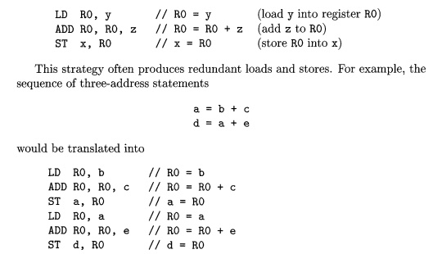

3. Instruction Selection
The nature of the instruction set of the target machine has a strong effect on the difficulty of instruction selection.
If the target machine does not support each data type in a uniform manner, then each exception to the general rule requires special handling.
For example, every three-address statement of the form x = y + z, where x, y, and z are statically allocated, can be translated into the code sequence

Slide 9
4. Register Allocation
Registers are the fastest computational unit on the target machine, but we usually do not have enough of them to hold all values.
Instructions involving register operands are invariably shorter and faster than those involving operands in memory, so efficient utilization of registers is particularly important.
The use of registers is often subdivided into two subproblems:
Register allocation, during which we select the set of variables that will reside in registers at each point in the program.
Register assignment, during which we pick the specific register that a variable will reside in.
Finding an optimal assignment of registers to variables is difficult, even with single-register machines. Mathematically, the problem is NP-complete.

Slide 10
5. Evaluation Order
The order in which computations are performed can affect the efficiency of the target code.
Some computation orders require fewer registers to hold intermediate results than others.

Slide 11
A SIMPLE CODE GENERATOR
Register and Address Descriptors:
A register descriptor is used to keep track of what is currently in each registers. The register descriptors show that initially all the registers are empty.
An address descriptor stores the location where the current value of the name can be found at run time.

Slide 12
A SIMPLE CODE GENERATOR
Input :Three-address statements of the form x : = y op z constituting a basic block.
Invoke a function getreg to determine the location L where the result of the computation y op z should be stored.
Consult the address descriptor for y to determine y’, the current location of y. Prefer the register for y’ if the value of y is currently both in memory and a register. If the value of y is not already in L, generate the instruction MOV y’ , L to place a copy of y in L.
Generate the instruction OP z’ , L where z’ is a current location of z. Prefer a register to a memory location if z is in both. Update the address descriptor of x to indicate that x is in location L. If x is in L, update its descriptor and remove x from all other descriptors.
If the current values of y or z have no next uses, are not live on exit from the block, and are in registers, alter the register descriptor to indicate that, after execution of x : = y op z , those registers will no longer contain y or z

Slide 13
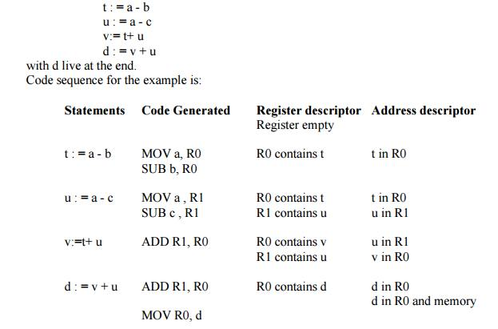
The assignment d : = (a-b) + (a-c) + (a-c) might be translated into the following three-address code sequence:

Slide 14
REGISTER ALLOCATION AND ASSIGNMENT
Local register allocation
Register allocation is only within a basic block. It follows top-down approach.
Assign registers to the most heavily used variables
Traverse the block
Count uses
Use count as a priority function
Assign registers to higher priority variables first
Advantage
Heavily used values reside in registers
Disadvantage
Does not consider non-uniform distribution of uses

Slide 15
REGISTER ALLOCATION AND ASSIGNMENT
Need of global register allocation
Local allocation does not take into account that some instructions (e.g. those in loops) execute more frequently. It forces us to store/load at basic block endpoints since each block has no knowledge of the context of others.
To find out the live range(s) of each variable and the area(s) where the variable is used/defined global allocation is needed. Cost of spilling will depend on frequencies and locations of uses.
Register allocation depends on:
Size of live range
Number of uses/definitions
Frequency of execution
Number of loads/stores needed.
Cost of loads/stores needed.

Slide 16
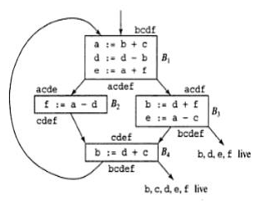
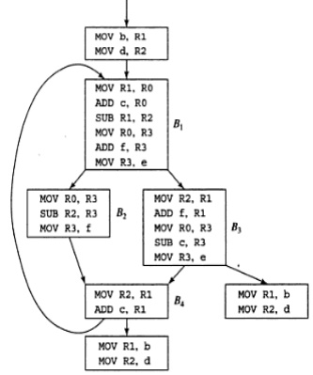
REGISTER ALLOCATION AND ASSIGNMENT
Register allocation by graph coloring
Global register allocation can be seen as a graph coloring problem.
Basic idea:
1. Identify the live range of each variable
2. Build an interference graph that represents conflicts between live ranges (two nodes are connected if the variables they represent are live at the same moment)
3. Try to assign as many colors to the nodes of the graph as there are registers so that two neighbors have different colors

Slide 17
PEEPHOLE OPTIMIZATION
Redundant-instructions elimination
Flow-of-control optimizations
Algebraic simplifications
Use of machine idioms
Unreachable

Slide 18
PEEPHOLE OPTIMIZATION
Redundant Loads And Stores:
If we see the instructions sequence
MOV R0,a
MOV a,R0
Flows-Of-Control Optimizations:
The unnecessary jumps can be eliminated in either the intermediate code or the target code by the following types of peephole optimizations. We can replace the jump sequence
goto L1
……..
L1: if a < b goto L2
L3:
by the sequence
If a < b goto L2
goto L3
…….
L3:
goto L1
….
L1: goto L2
by the sequence
goto L2
….
L1: goto L2
if a < b goto L1
….
L1: goto L2
by the sequence
if a < b goto L2
….
L1: goto L2

Slide 19
PEEPHOLE OPTIMIZATION
Algebraic Simplification:
Only a few algebraic identities occur frequently enough that it is worth considering implementing them. For example, statements such as
x := x+0 or
x := x * 1
Reduction in Strength:
Reduction in strength replaces expensive operations by equivalent cheaper ones on the target machine.
X² → X*X

Slide 20
PEEPHOLE OPTIMIZATION
Use of Machine Idioms:
The target machine may have hardware instructions to implement certain specific operations efficiently.
i:=i+1 → i++
i:=i-1 → i- -
Unreachable Code:
Another opportunity for peephole optimizations is the removal of unreachable instructions. An unlabeled instruction immediately following an unconditional jump may be removed.
#define debug 0
….
If ( debug ) {
Print debugging information
}
by the sequence
If debug =1 goto L1
goto L2
L1: print debugging information
L2:
If debug ≠1 goto L2
Print debugging information
L2: ……………………………
Or
If debug ≠0 goto L2
Print debugging information
L2: …………………

